Slide 1

Department : Software Engineering Course Title : System Analysis And Design project Course Code : SE231 Section : A Teacher Initial : KBB Date : 6th June 2021

Slide 2
Project Name : Hostel Management System
Member
Name : Abu Saleh MD Shahriar Hayder Annoy
Id: 193-35 -2938
Name : Md. Fahim Bhuiyan
Id : 193-35-2898

Slide 3
Contents
Overview
Background
Objectives
Scope
Assumptions and Constraints
Dependencies and Risks
Project Delivery
Timescales
Work Distribution
Project Resources
Summary

Slide 4
Background
To reduce human suffering we can use a software system for Hostel management systems(HMS). In the traditional system hostel admin keeps all details on the register paper. But now they can keep all things in the software system. They can show their hotel online to users or customers. Customers can choose their favourite room or they can search their room. Also they can select which types of room they want, Ac/ non-Ac, single bed or double bed, expensive room or normal room etc. This software system is to make the performance of certain tasks faster than humans. There customers can order food in online, also they can say their opinion about what they need, what they want etc. They can pay their payment online also. Hostel admin save all data at database so there is no fear of losing data here. So this system is very helpful for users or customers.

Slide 5
Objectives
Hostel management system(HMS) will be a web based system for reducing time and trouble. The system will have different level of user -
1.System Administrator
2. Users
3. Hotel admin
**List of operation that the system will provide are-
1. Customers can show rooms and can select room.
2. They can communicate with admin through the system
3.They can pay through the system.
4.System save all details or data of customers
5.Customers can order food through the system

Slide 6
Scope
The project hotel management system will be an web based system that will be used for maintaining the records in an organized manner and replace old paper work system. This project aims at automation the hotel management for smooth working of the hotel by automating almost all the activities.
Updates and modifications will be easily achievable and all the calculations and accounting work would be accurate. Hotel management system will reduce customers time and trouble. Customer can easily show all rooms in system.
Which room is available or which room is unavailable . Then they can search or select which types of room they want Ac/non-Ac , single bed or double bed etc. After the room reservation system give them one card with their id. When customer show the card to hotel admin then admin confirm the room. Customer can also order food and tell the admin about all their problem.

Slide 7
Assumptions and Constraints
It is assumed that the users or customers are comfortable with computers or smartphones. Customers also need to know how to use the internet . Admin need to know how to save the user details and how to respond to user messages. Since everyone will use this system, here we use english and bangla language also we use pictures as if people can easily understand.

Slide 8
Dependencies and Risks
The user must have web access in order to use the system. The main risk behind implementing the project is security. Since customers can pay bill online, there is a risk. If somebody hacked the system then all things we can lose. So during development it will be one of our major concerns. Another concern is having common bugs such as the common users having the same functionalities as the doctors or system admin.

Slide 9
Project Delivery
Deliverables
The following contents will be delivered with the project:
Project Demo
User manual along with Tutorial
Documentation

Slide 10
Timescales
The time frame for implementing the project is given in Figure 1.2.1.
Work Distribution
The work distribution of the project is given in Table 1.2.1.
Project Resources
The resources required to finish the project is given in Table 1.2.2.

Slide 11
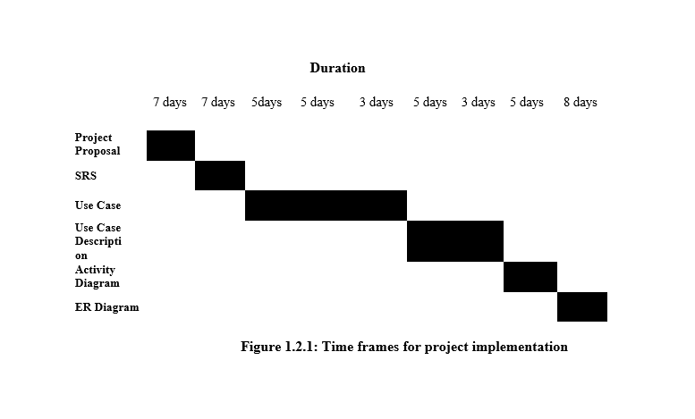

Slide 12
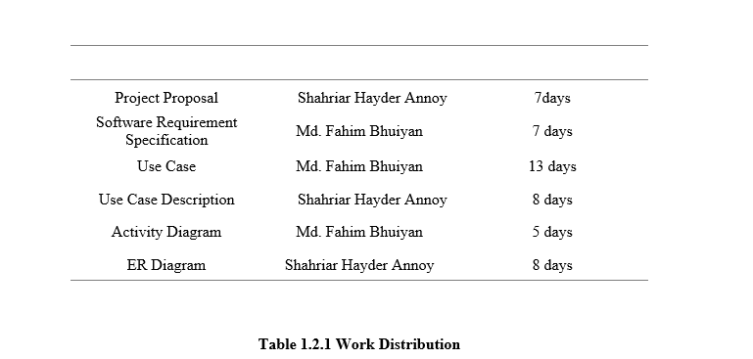

Slide 13
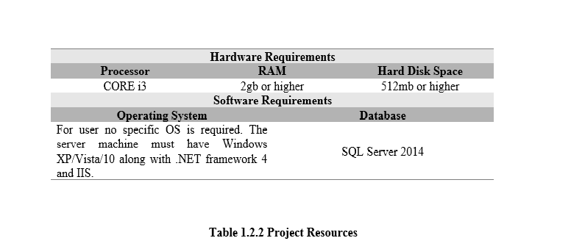

Slide 14
Summary
Time is our most valuable asset. We cannot waste it when there is scope of utilizing it in a better way. Our proposed system named HMS will be developed to meet this purpose. It will save the time of the mass people wasted during the time.
Along with this, HMS will also help the administrator to see the previous records of a all customer. As a result s/he can take decisions more wisely. If the customer loses his/her information s/he can retrieve it from the website. We hope that HMS is useful for customer and administrator also. Our whole nation will be beneficial specially rural people will get benefit from this sytem.

Slide 15
References
1. What things are on the hotel website. Link = (https://blog.staah.com/online-marketing/15-things-a-hotels-website-must-have)
2. Best 10 hotel websites. Link = (https://www.smartertravel.com/best-hotel-booking-sites/)
3. What requirements are needed to make a hotel website? Link = ( https://www.wix.com/blog/2018/09/create-hotel-website/)

Slide 16
Thank You

